Slide 1
Navigating Medicare in 2026
Dana Saffel, PharmD, BCGP, CPh
President, CEO
October 30, 2025

Slide 2



Medicare – Medical Care for the Elderly & Disabled
Part A
Helps cover:
Inpatient care in hospitals
Skilled nursing facility care
Hospice care • Home health care
Part B
Helps cover:
Services from doctors and other health care providers
Outpatient care
Home health care
Durable medical equipment (like wheelchairs, walkers, hospital beds, and other equipment)
Many preventive services (like screenings, shots or vaccines, and yearly “Wellness” visits)
Part D
Helps cover the cost of prescription drugs (including many recommended shots or vaccines).
Plans that offer Medicare drug coverage (Part D) are run by private insurance companies that follow rules set by Medicare.

Slide 3
Medicare Plan Options
Original Medicare
Medicare Advantage
Includes Medicare Part A (Hospital Insurance) and Part B (Medical Insurance).
You can join a separate Medicare drug plan to get Medicare drug coverage (Part D).
You can use any doctor or hospital that takes Medicare, anywhere in the U.S.
You can also use or shop for and buy a Medicare Supplement (Medigap) that helps pay your Part A & Part B out-of-pocket costs (like your 20% coinsurance).
A Medicare-approved plan from a private insurance company that offers an alternative to Original Medicare for your health and drug coverage. These plans bundle together your Part A, Part B, and usually Part D.
You may need to use doctors in its network and get approval for certain drugs or services.
Usually have different out-of-pocket costs than Original Medicare, including a limit on out-of-pocket costs.
Medigap coverage is not available.
Most plans offer extra benefits that Original Medicare doesn’t cover— like vision, hearing, dental, and more.

Slide 4
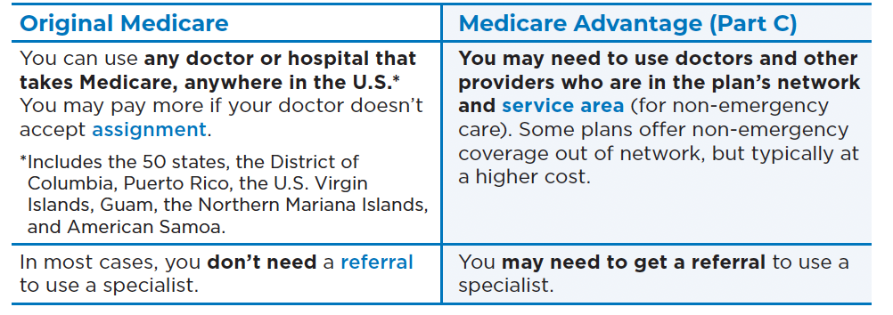
Doctor and Hospital Coverage

Slide 5


Cost
For Part B-covered services, you usually pay 20% of the Medicare-approved amount after you meet your deductible. This amount is called coinsurance. (If you have a Medigap plan, it covers this 20%) so you pay zero.)
You pay the monthly premium for Part B (and any IRMAA tax). If you choose to join a Medicare drug plan, you may pay a separate premium for your Medicare drug coverage (Part D)
There is no yearly limit on what you pay out-of-pocket, unless you have a Medicare Supplement (Medigap) plan or Medicaid, employer, retiree, or union coverage.
You can choose to buy Medigap to help pay your out-of-pocket costs that Medicare doesn’t cover.
Out-of-pocket costs vary. Plans may have different out-of-pocket costs for certain services.
You pay the monthly Part B premium (any any IRMAA tax) and may also have to pay the plan’s premium. Some plans may have a $0 premium and may help pay all or part of your Part B premium. Most plans include Medicare drug coverage (Part D), so you don’t have a separate Part D premium.
Plan have a yearly limit on what you pay for covered Medicare services (which may include different limits for in-network and out-of-network services). Once you reach your plan’s limit, you’ll pay nothing for covered services for the rest of the year.
You cannot buy Medigap to cover your out-of-pocket costs. However, you may e able to use coverage from a current or former employer or union, or Medicaid (if you qualify).
2026 Standard monthly premium: $206.50
2026 Annual deductible: Estimated at $288
IRMAA: Higher-income individuals will pay a higher premium based on their 2024 tax return.

Slide 6
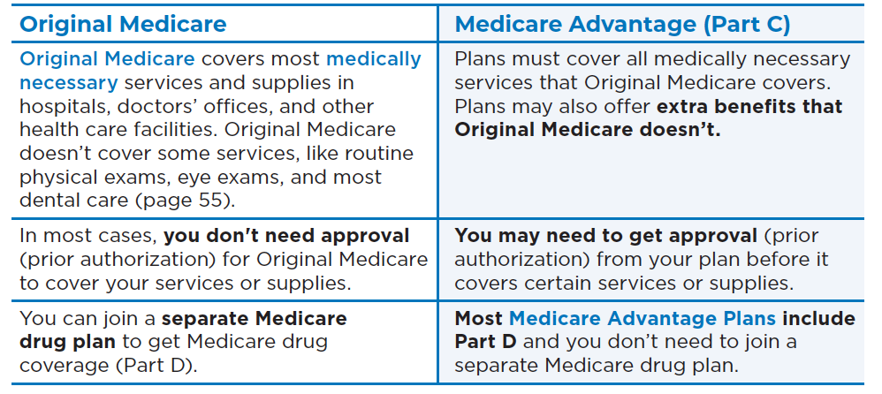

Services Covered

Slide 7
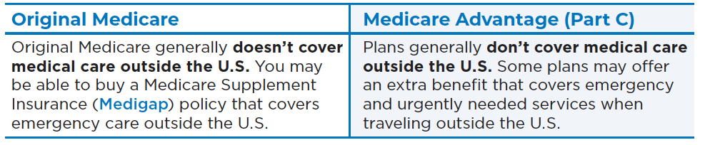
Foreign Travel

Slide 8
Biggest Differences Between Original Medicare and Medicare Advantage
Original Medicare + MediGap + Drug Plan
Medicare Advantage
Any doctor
No referral needed for specialist
Any hospital or nursing home
Easier to get admitted to your choice of nursing home if rehab is needed
Can select MediGap plan that best meets your needs
Will cover your Part A & B out-of-pocket costs
Can select Drug plan that best meets your needs
No dental, hearing or vision
No gym membership
No transportation coverage
No meal assistance
Optional travel abroad coverage
Must use in-network doctor for non-urgent care
Referral needed for specialist
Must use in-network hospital or nursing home for non-urgent care
More limited options for nursing home care if rehab is needed
No MediGap plan available
Must use the Drug plan offered by the plan
Optional dental, hearing, vision
Optional gym membership
Optional transportation to doctor’s office
Option meal assistance
No travel abroad coverage
Optional services may not be available in every zip code
Medigap plans C, D, F, G, M and N generally cover some type of travel-abroad emergency help.

Slide 9
Selecting the Right Medicare Plan for You
Initial Enrollment – select a plan
7-month period around when you turn 65
3 months before, the month of your 65th birthday, 3 months after
Annual Enrollment – keep or change your plan – effective January 1st
October 15th to December 7th (each year)
Jan 1st – March 31st – if you are in a Medicare Advantage plan, you can change to another Medicare Advantage plan or select Original Medicare + Part D once during this period.
Be aware that if you switch from Medicare Advantage back to Original Medicare, the Medicare Supplement (Medigap) plans do not have to guarantee you cover or offer you the lowest price. They may consider pre-existing conditions during coverage determination.
Special Enrollment Periods – change your plan
Moving: when you move to a new address that is not in your plan’s coverage area or where your plans options there are different (important with Medicare Advantage)
Nursing homes or long-term care hospitals: when you enter, each month while you are living there and for 2 months after you leave
Medicaid: you become eligible
Can change 1 time per quarter (Jan – Mar, Apr – Jun, Jul – Sept)

Slide 10
Evaluating Drug Coverage – Getting Set …
Go to: www.medicare.gov
Select the type of plan (Original Medicare or Medicare Advantage)
Enter zip code
Enter any “you have help” paying for costs (if they apply)
Enter the drugs you take (or are considering)
Your list does not have to match what you are taking today. You can enter alternatives that you are considering to determine the impact of using different medication options
Include dose and # of tablets per month/quarter
Enter your zip code (again)
Select up to 5 pharmacies
Enter how many miles you are willing to drive (1, 5, 10, 25 miles)
Medicare.gov sorts plans by lowest drug and premium cost (default), but you can change the sort

Slide 11
Evaluating Drug Coverage … The Details
Scroll through the available plans and note the plans that best meet your needs
Note the top 5 plans you’ve selected, then go back to each one and:
Click on Plan Details – check that these meet your needs
Scroll down to Prescription Drug You Are Viewing
You can select each drug in your drug list to view costs by pharmacy
Click on View More Drug Coverage
Note any drugs that require:
Prior authorization (must submit clinical diagnosis or other evidence that the medication is needed), or
Step therapy (must try and fail one or more formulary preferred drugs)
If a needed medication has a restriction on use, visit the plan’s website to review the prior authorization and/or step therapy criteria
Look up “Prior Authorization Form” or “Request for Drug Coverage Determination”
For 2026, the maximum total out-of-pocket for covered Part D drugs is $2100

Slide 12
Medicare Prescription Payment Plan
Medicare Prescription Payment Plan is a payment option that works with your current drug coverage to help you manage your out-of-pocket costs for drugs covered by your plan by spreading your drug costs across the calendar year (January–December).
Anyone with a Medicare drug plan or Medicare Advantage plan with drug coverage can use this payment option. All plans offer this payment option, and participation is voluntary.
If you select this payment option, each month you’ll continue to pay your plan premium (if you have one), and you’ll get a bill from your health or drug plan to pay for your prescription drugs (instead of paying the pharmacy).
There’s no cost to participate in the Medicare Prescription Payment Plan.

Slide 13

Let’s give it a try at www.medicare.gov

Slide 14
Uplizna (inebilizumab-cdon) and ULTOMIRIS (ravulizumab-cwvz)
Biologic administered IV – generally at a physician’s office or infusion center
Covered by Medicare Part B medical benefit (Original Medicare)
No prior authorization
20% coinsurance is covered by Medigap plan
Covered by Medicare Advantage plan as a Part B medical benefit
Requires prior authorization (can be very stringent)
20% coinsurance is responsibility of beneficiary
Covered by Commercial Insurance as a medical benefit
Prior authorization may be required
Coinsurance may apply
A program called Amgen By Your Side is available for Uplizna. For more information and to find out whether you’re eligible for support, call 833-842-8477 or visit the program website.
The Alexion OneSource™ CoPay Program helps people pay for eligible out-of-pocket medication and infusion costs for Ultomiris. AlexionOneSource.com
Some websites provide details about drug assistance programs, ways to make the most of your insurance coverage, and links to savings cards and other services. Two such websites are:
Medicine Assistance Tool
NeedyMeds
Payment assistance is only available for patients paying cash or covered by Commerical insurance

Slide 15
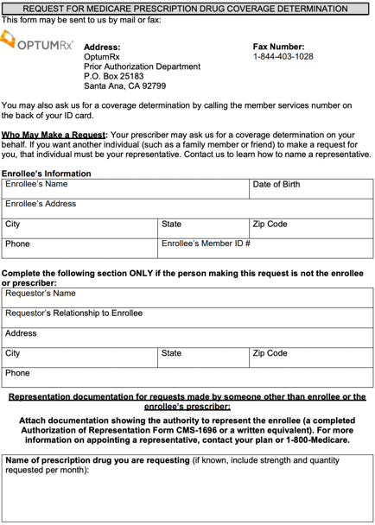
Part D Drug Coverage Determination (aka Prior Authorization) – Page 1
Download the plan’s form
Who can submit for drug coverage?
Your doctor
YOU
A friend of family member whom you have designated your responsible party
Enter your information and the responsible party’s information on Page 1
All Medicare Part D plans use a similar form. Only the plan logo and contact info changes

Slide 16
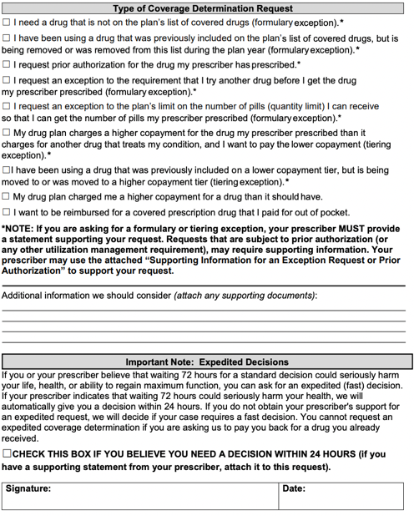
Drug Coverage Determination – Page 2
Check the reason for requesting the coverage determination
Requests for a non-formulary drug to be covered – or – for a high-cost drug to be provided at a lower cost – require documentation from your doctor
This documentation can be provided in the area on the form or attached – but also must be included at the bottom on page 4
Check for expedited (24 hour) review
Signature – yours or your responsible party – or your doctor

Slide 17
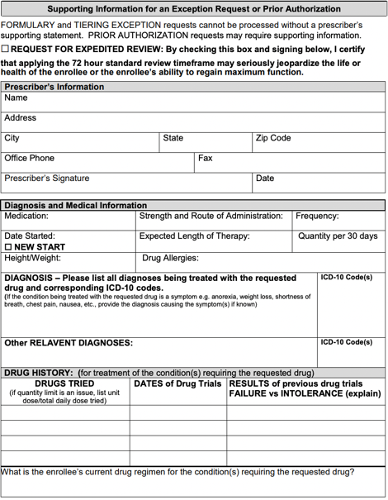
Drug Coverage Determination – Page 3
Complete Doctor information
Doctor’s signature is required if requesting coverage for a non-formulary drug or to get an expensive drug at a lower copay
Complete diagnosis and medical history
Add other relevant diagnosis
Add description of medical needs that supports why other drugs are inappropriate
Add other drugs tried that are related to the drug being requested and the results of those drug treatments

Slide 18
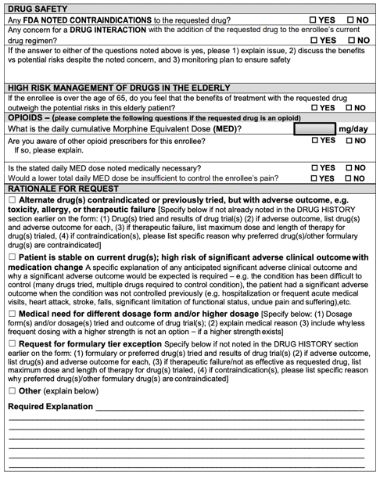
Drug Coverage Determination – Page 4
Check any drug safety regarding the requested drug
Should be NO
Check High Risk Management
Should be YES
Opioids
Does not usually apply to EGPA, GPA, MG or IgG4 meds
Check appropriate rationale for the request
Fax form to plan
Fax number is at top of page 1
Doctors can sign-up to complete and submit the Coverage Determination Form on-line

Slide 19
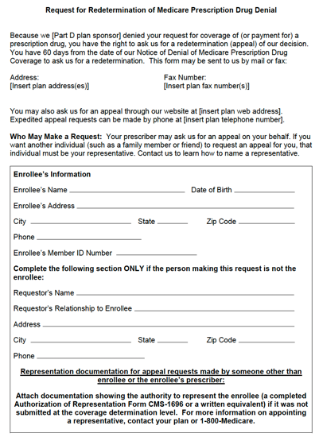
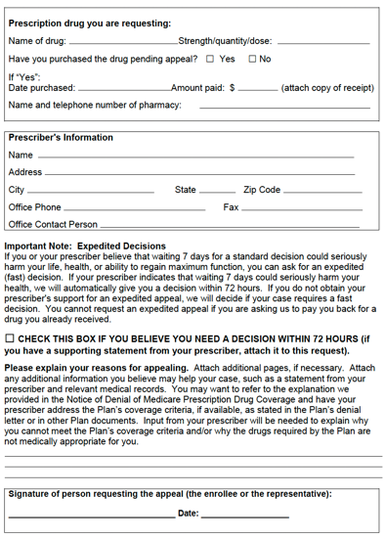
Request for Redetermination of Prescription Drug Denial
https://www.cms.gov/Medicare/Appeals-and-Grievances/MedPrescriptDrugApplGriev/Forms
If your Medicare Part D plan denies your coverage determination request, you can file a
Request for Redetermination within 60 days of receiving the denial
Plan must make the redetermination decision within 7 days
Can request expedited (72 hour) review

Slide 20
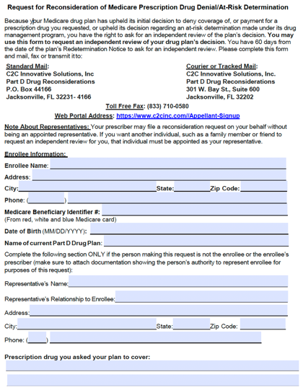
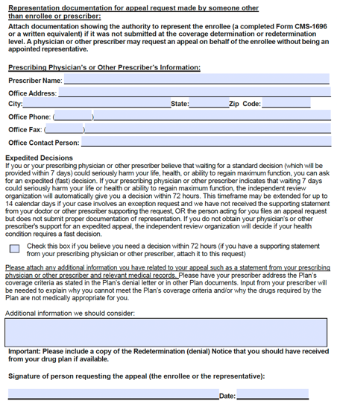
Request for Reconsideration of Prescription Drug Denial
https://www.cms.gov/Medicare/Appeals-and-Grievances/MedPrescriptDrugApplGriev/Forms
If your Medicare Part D plan denies your Request for Redetermination, you can
Request a Reconsideration within 60 days of receipt of plan’s Redetermination
This Reconsideration Request goes to an Independent Reviewer

